Slide 1
CAMEO Names
JRC-NAMES: A Freely Available, Highly Multilingual
Named Entity Resource

Slide 2
CAMEO Data Set
Phoenix.agents.txt
Lines Processed for Cameo.Phoenix.agents is : 2292
Records created for Cameo.Phoenix.agents is : 1972
Phoenix.Countries.actors.txt
Lines Processed for Cameo.Phoenix.Countries.actors is : 54410
Records created for Cameo.Phoenix.Countries.actors is : 286
Phoenix.International.actors.txt
Lines Processed for Cameo.Phoenix.International.actors is : 7976
Records created for Cameo.Phoenix.International.actors is : 7526
Phoenix.MilNonState.actors.txt
Lines Processed for Cameo.Phoenix.MilNonState.actors is : 2680
Records created for Cameo.Phoenix.MilNonState.actors is : 959

Slide 3

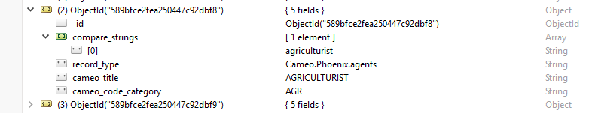
Phoenix.agents

Slide 4
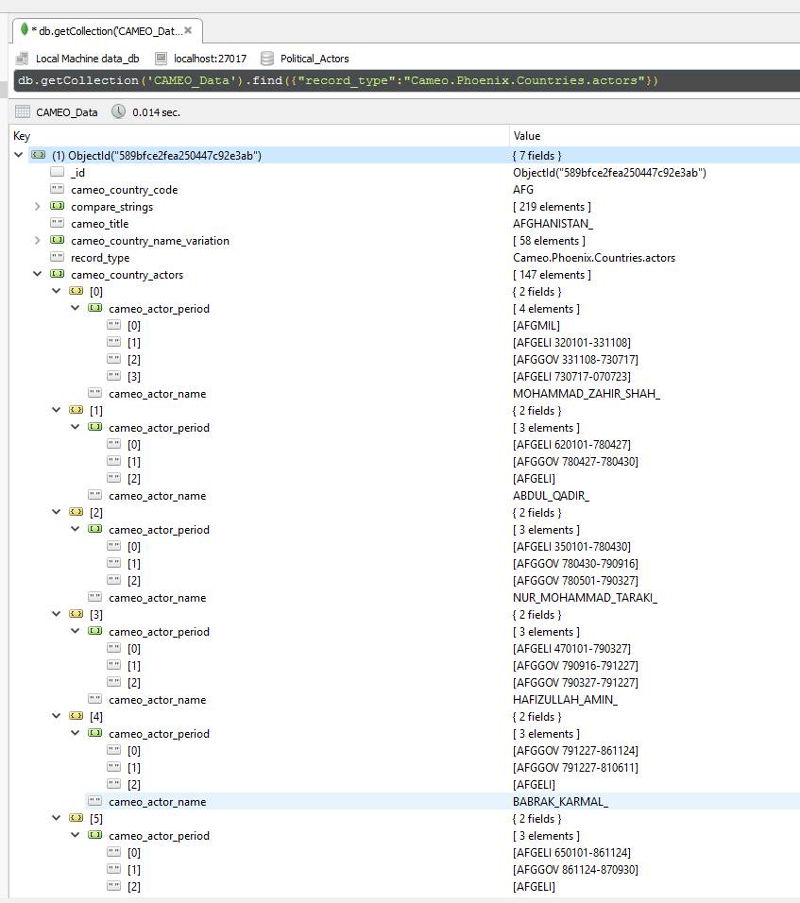
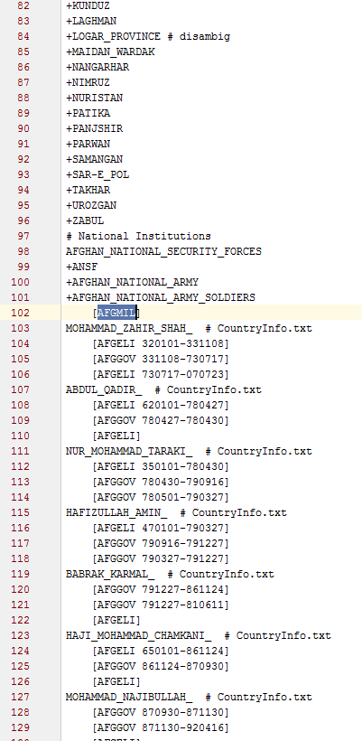
Phoenix.Countries.actors

Slide 5
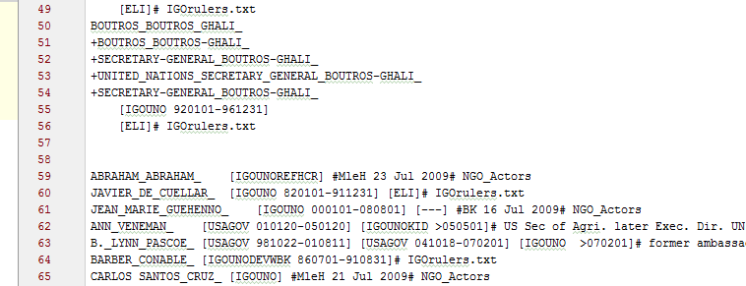
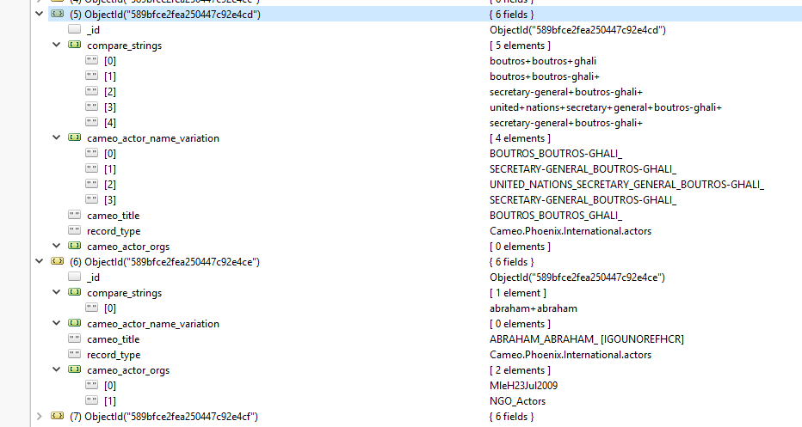
Phoenix.International.actors & Phoenix.MilNonState.actors

Slide 6
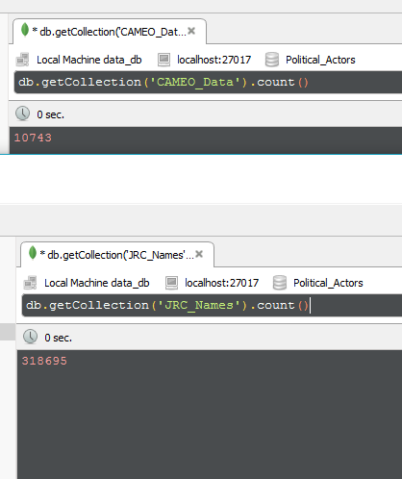
3,423,740,385,000 approx.. String comparisons needed for finding relation

Slide 7
Reference
CAMEO Data: https://github.com/openeventdata/UniversalPetrarch/tree/master/UniversalPetrarch/data/dictionaries
Code Repo : https://github.com/SubhasisDutta/JRC-Name-Parser

